Slide 2
Objectives
Describe how data is transmitted from one device to another using different methods of data transmission including:
Serial, Parallel
Simplex, Half-duplex, Full-duplex
Explain the suitability of each method for a scenario
Explain the advantages and disadvantages of each method
Understand the universal serial bus (USB) interface and explain how it is used to transmit data

Slide 3


Starter
A tin can telephone allows one person to transmit a message in binary by saying 1 or 0
How is it possible for both people to send a message to each other?
How could messages be sent faster?

Slide 4
Starter
How is it possible for both people to send a message to each other? They would need to swap the cans from ear to mouth and vice versa A keyword such as ‘over’ could be used to signify the end of a transmission in one direction
How could messages be sent faster? Two connections could be made – one for listening and one for speaking – in Computer Science this is known as half-duplex Alternatively, they could speak each digit faster – this is a serial transmission and the way that technologies such as USB are faster than older technologies such as computer serial ports

Slide 5


Serial transmission
Bits are sent one signal at a time over a single wire
One bit is sent at a time
Once the bit has been received, the next bit is sent
The example below shows how the ASCII ‘W’ character is sent in binary
0
1
0
1
0
1
1
0
Receiver
Sender

Slide 6
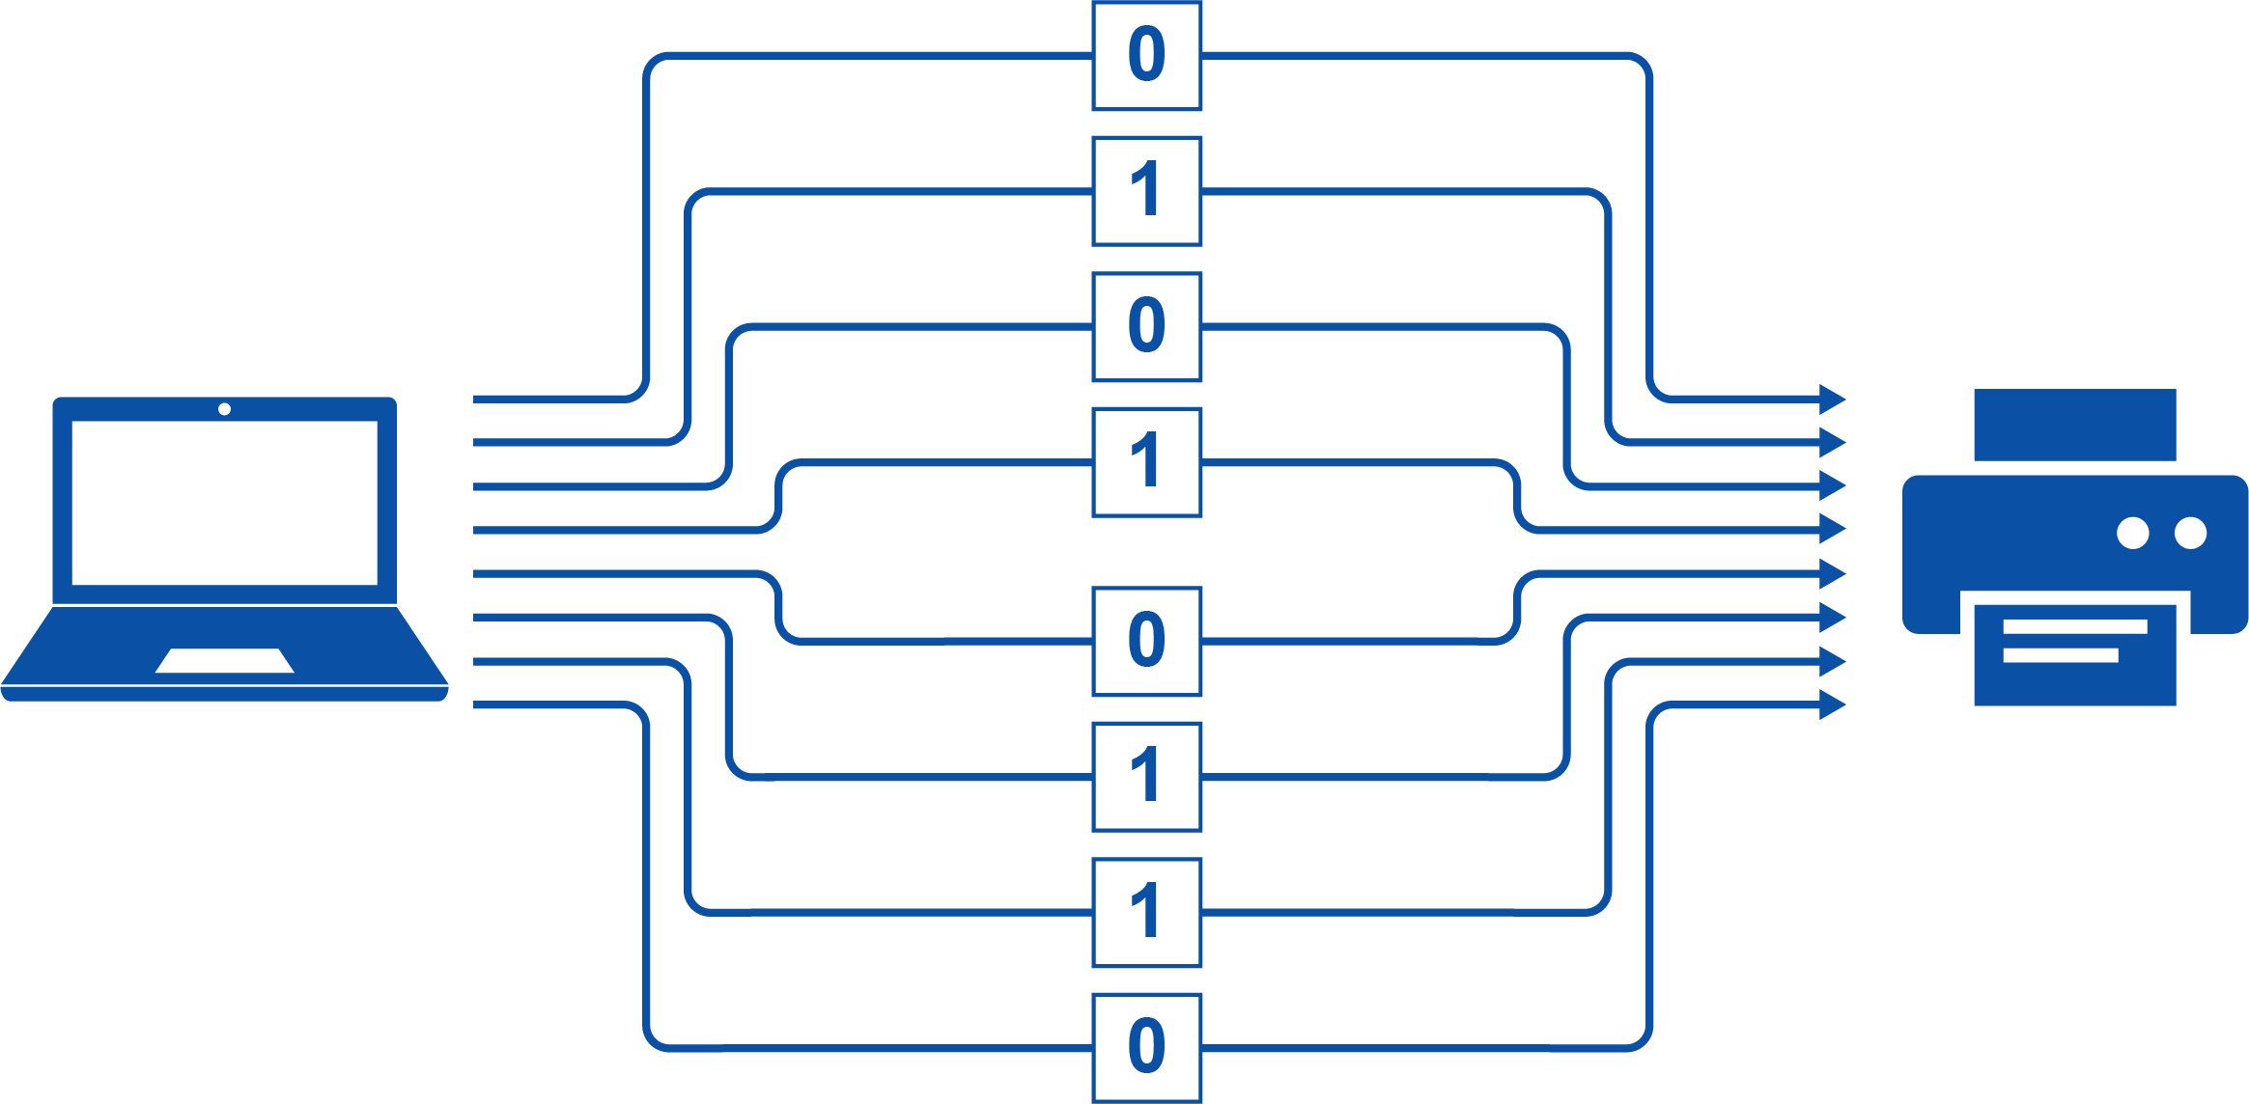
Parallel transmission
In parallel transmission a number of wires are used so that many bits may be sent at the same time
Again, the ASCII letter ‘W’ is sent in binary
Which is faster, parallel or serial transmission?
Sender
Receiver

Slide 7
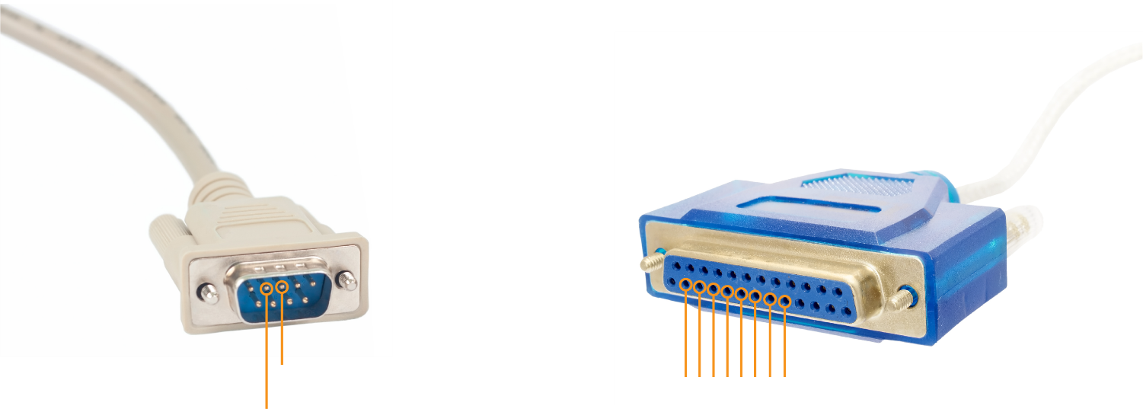
Parallel vs serial transmission
If the same speed is used for one serial wire or eight parallel wires then parallel transmission will be faster
Serial cable
Parallel cable
Transmit Data (TXD)
D0~D7
Receive Data (RXD)
Allows the parallel transmission of 8 bits

Slide 8
Worksheet 2
Now complete Task 1 on Worksheet 2

Slide 9
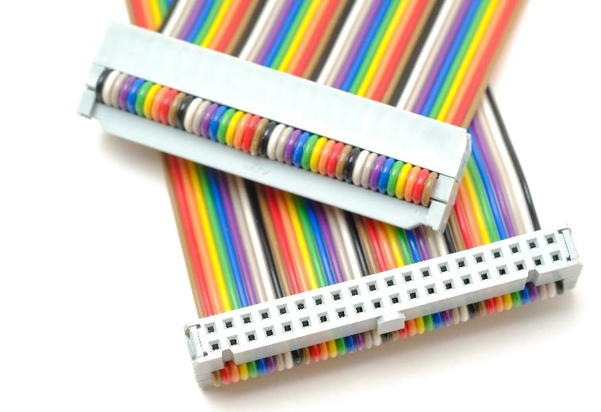
Data cables
It was common in older computers to use parallel cables to connect devices
They were used for hard disk drives and floppy drives
The parallel cables enabled faster transmission speeds than serial cables
This type of cable was used in parallel ATA (PATA) and IDE cables
40 pins were on the cable, with the ability to send 16 bits of data in parallel through pins 3 to 18

Slide 10
What’s wrong with parallel?
Parallel cables are able to send more data than serial cables if the same data rate is used
They were very common in computers before around the year 2000
But they have been replaced by SATA cables (Serial ATA) and USB cables (Universal Serial Bus)
Why are parallel cables not commonly used now if they were the faster type of cable before the year 2000?

Slide 11
Crosstalk
Crosstalk may occur when a signal on one line creates a disturbance in another line
This may cause a bit to be reversed in a parallel line
The longer a cable is, the more chance there is of crosstalk
0
D0
0
D1
The number 01010110 is transmitted, lines D3 and D5 are causing cross talk on D4 so that the number 01011110 is received
1
1
0
D2
0
1
D3
1
Sender
Receiver
0
D4
1
1
D5
1
1
D6
1
0
D7
0

Slide 12
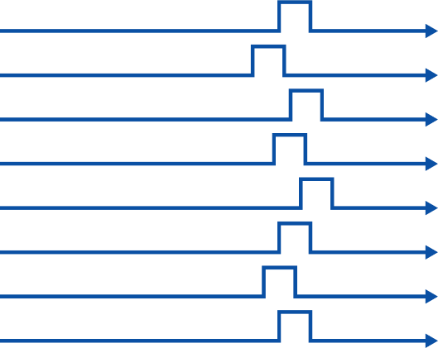
Skew
Each wire in a parallel cable has slightly different properties
Signals therefore arrive at slightly different times
The receiver must wait until all lines are received until the next set of bits may be sent
Transmission needs to be over very short distances to reduce the problem

Slide 13
Advantages of serial
Before around the year 2000, processors were expensive and not fast enough to keep up with very fast transmissions in serial
Parallel transmission was therefore used to increase the overall transmission speed
As processors have increased in speed, they can easily cope with faster serial transmission rates
By using serial transmission, faster rates are possible without the issues of crosstalk or skew
This is why modern transmission methods such as SATA (for hard drives) and USB (for external devices) are now most common

Slide 14
Advantages of serial
Serial cables only require one wire for the data itself
This means that far fewer wires are needed in the cable, making it cheaper to make and smaller
This also allows for longer cables without the risks of greater crosstalk and skew

Slide 15
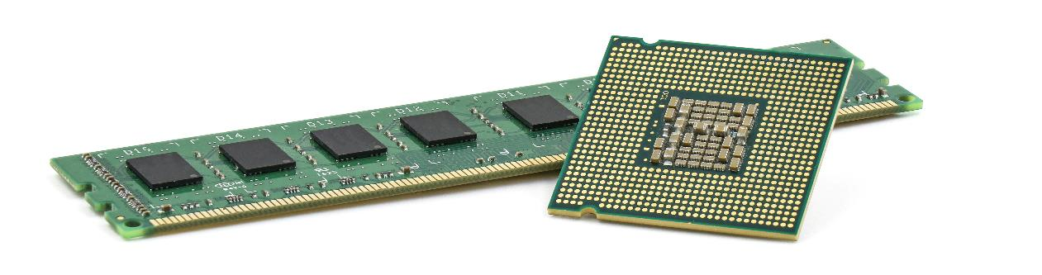
Integrated circuits
Parallel transmission still occurs inside computers
Data needs to be transferred between CPU and RAM very quickly
On a 64-bit CPU, a full 64-bit binary number will be transferred in parallel in one clock tick
Because the components are very close to each other, skew and crosstalk are less of an issue

Slide 16
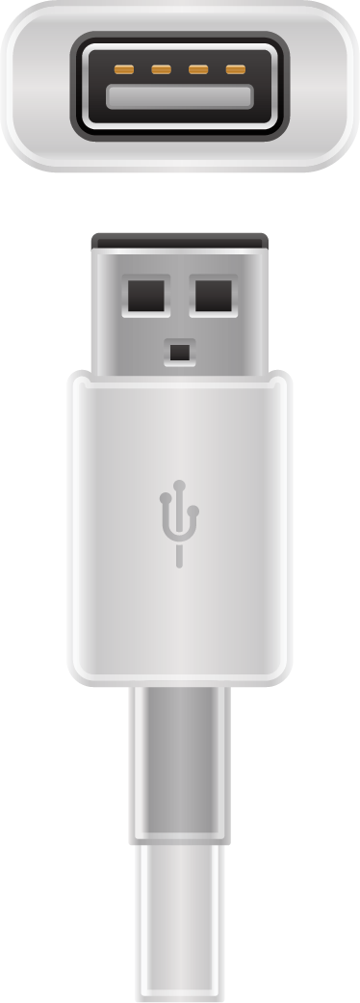
USB features
Universal serial bus (USB) is a serial cable that is commonly used to connect external devices to computers, laptops, tablets and smartphones
The USB cable may be plugged in or removed whilst the device is turned on
To connect older cables, such as serial mice or keyboards and parallel printers, the computer first needed to be turned off
Data+
Data-
+5V
Ground

Slide 17
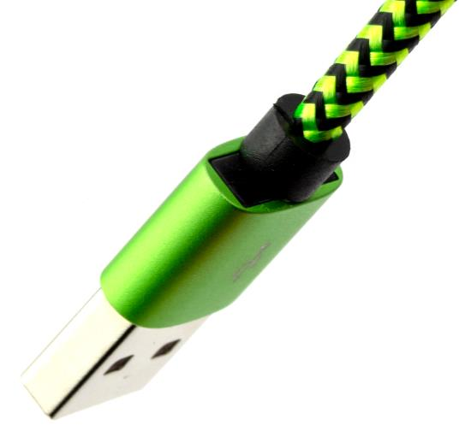
USB benefits
USB 1 connections operate between 1.5 and 12 Mbps
Parallel cables operate at a much slower 110 kbps
The later standard of USB 3 operates up to 20 Gbps
Older parallel and serial cables normally required small screws to connect the cables
All sorts of devices could be connected by simply installing the necessary drivers

Slide 18
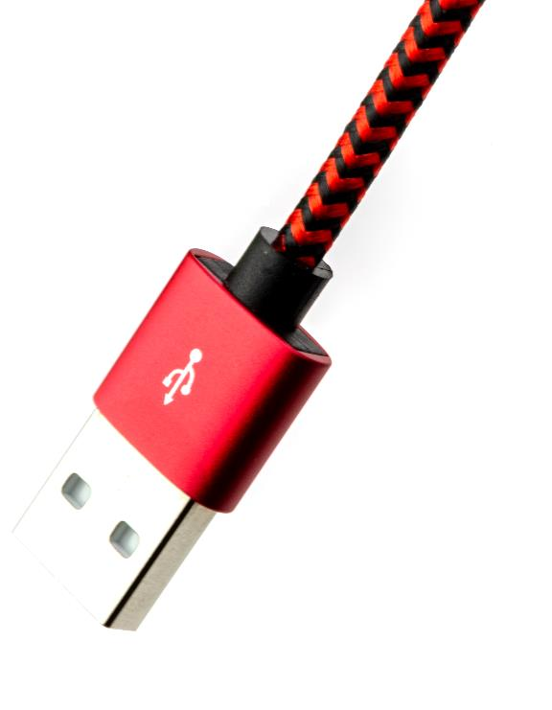
USB drawbacks
USB connections should only be 5 meters in length before a USB hub is used
The data transfer speeds are not fast enough to use in internal devices such as CPU and hard drive
The transfer of data with DDR4 RAM is up to 200 Gbps
This is around 10 times faster than USB 3

Slide 19
Worksheet 2
Now complete Task 2 on Worksheet 2

Slide 20
Transmission direction
Simplex, duplex and half-duplex are terms referring to the direction of data during transmission
These terms can be used in conjunction with serial and parallel transmission terminology

Slide 21
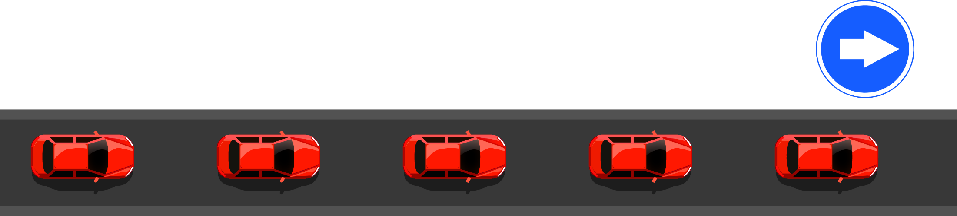
Simplex transmission
In simplex transmission, data travels in one direction only
This would be used to send data from a keyboard to a computer
Simplex transmission is similar to traffic flowing a one way road

Slide 22
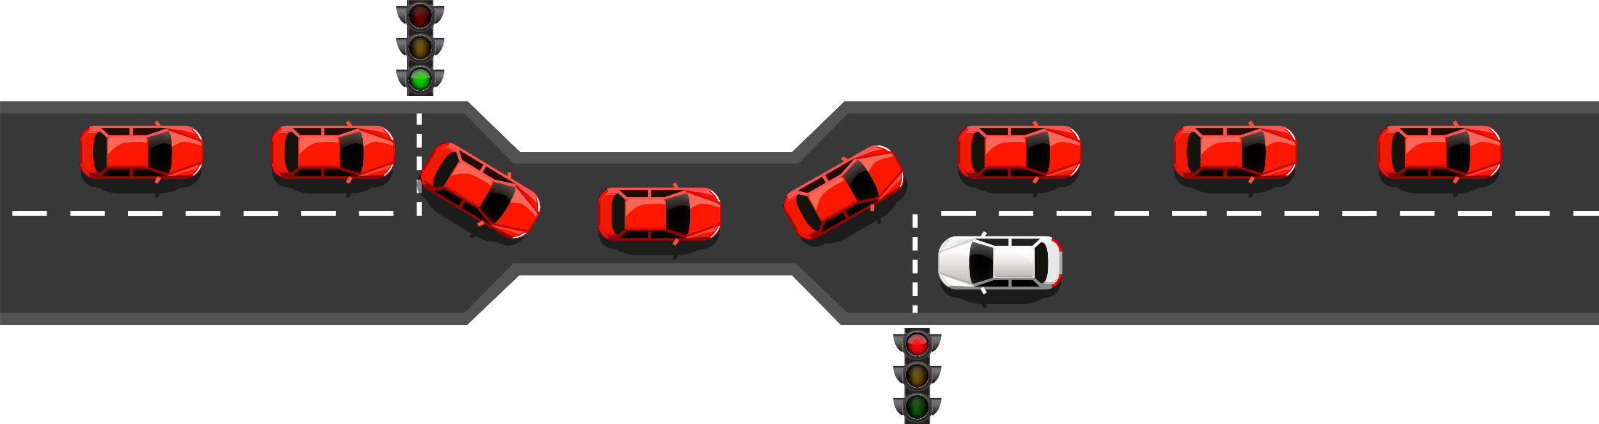
Half-duplex
Data is able to travel in both directions along a single connection, but it cannot travel at the same time
The full bandwidth is available to both the sender and receiver but they cannot send at the same time as receiving
This is similar to traffic lights into a one-way system

Slide 23
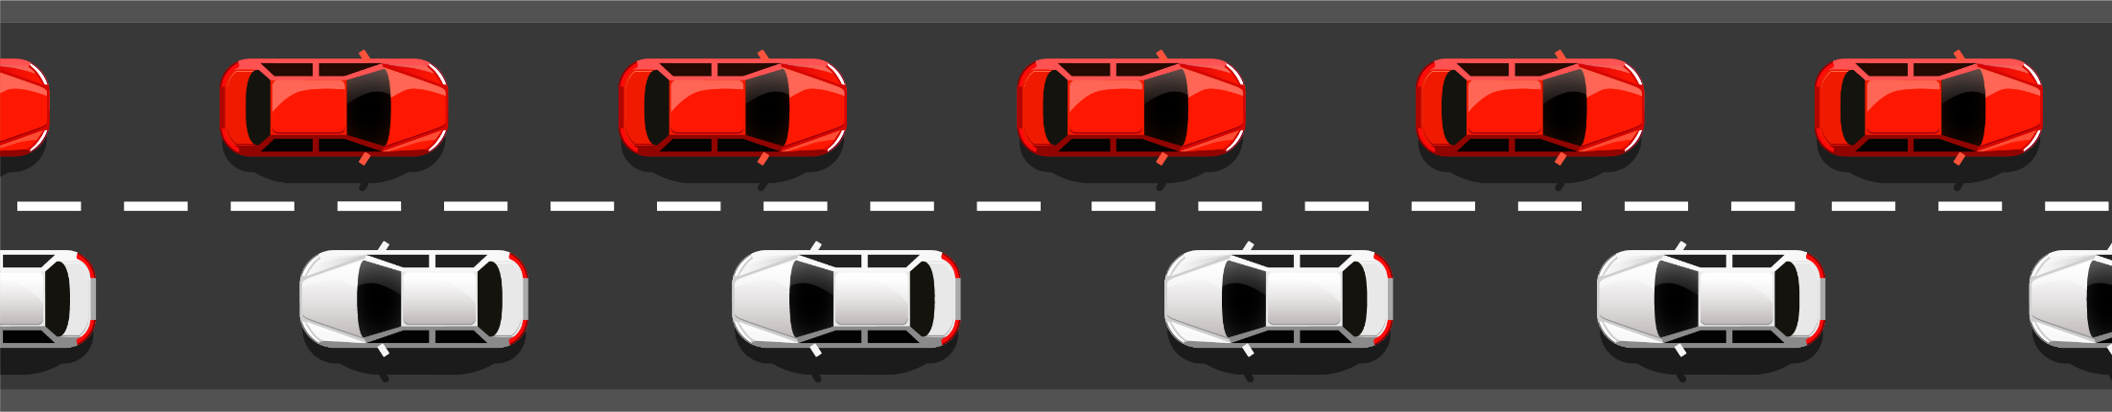
Full duplex transmission
In full duplex transmission, traffic is able to move in both directions simultaneously using two cables
Ethernet network cables make use of two twister pairs of cable – one for sending and one for receiving
Fibre optic cables use two fibres – one for transmitting and one for receiving

Slide 24
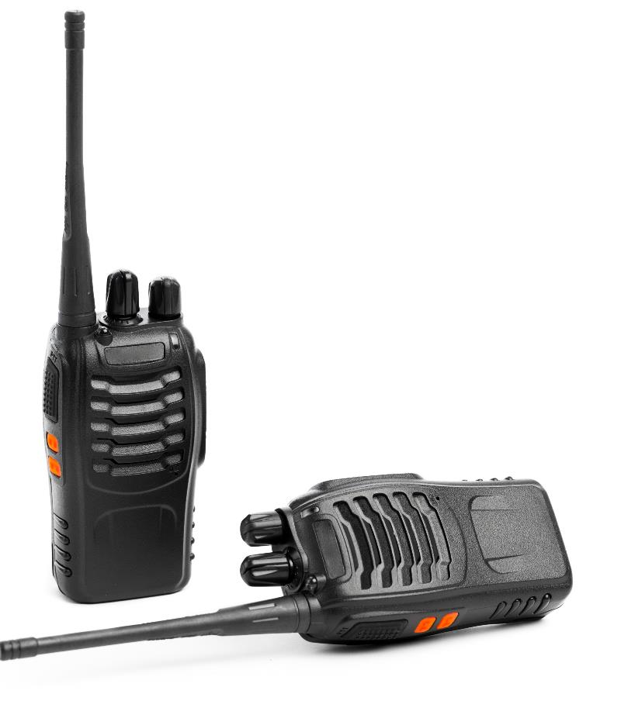
Transmission direction
Walkie Talkies (handheld transceivers) allow users to use one channel to send and receive audio
Only one radio on the channel is able to transmit at one time
Once the transmission ends, the other radio is able to transmit
Explain the type of transmission that is being used

Slide 25
Walkie talkies
To transmit on a walkie talkie, a push to talk (PTT) button is pressed
This stops the walkie talkie from receiving
The system is half-duplex – each walkie talkie can send and receive, but not at the same time

Slide 26
Worksheet 2
Now complete Task 3 on Worksheet 2

Slide 27

Plenary
Use an analogy of cars driving on a road to take turns to explain to a partner each of the following transmission terms:
Serial
Parallel
Simplex
Half-duplex
Full-duplex

Slide 28
Plenary
Serial – This is the same as a one-way road. Cars are sent along the road one car at the time (where a car is like one bit of data)
Parallel – This is like a motorway (probably with 8 lanes) where multiple cars are sent through at the same time
Simplex – Cars only travel in one direction, like on a one-way road
Half-duplex – Cars can travel in both directions on the same road – but only one direction at a time. This is similar to a section of road with a single lane controlled by traffic lights
Full-duplex – Cars can travel in both directions at the same time – this is similar to a standard road, dual carriageway or motorway

